Slide 1

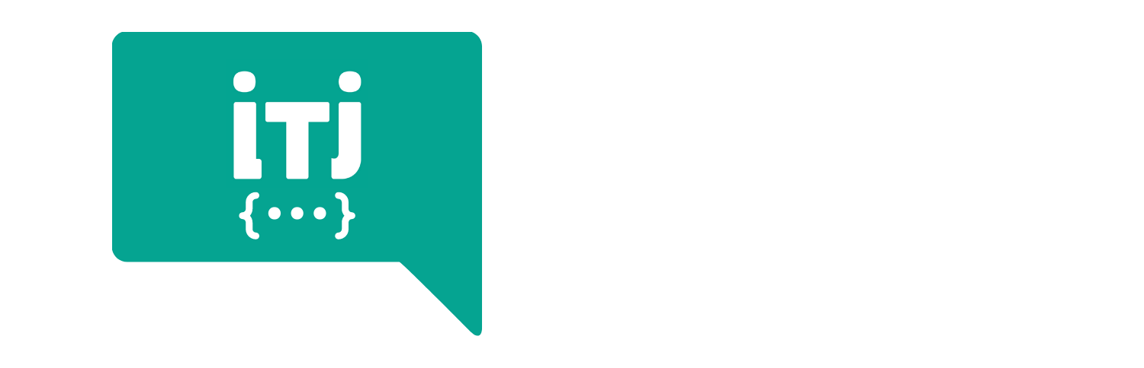
DevOps Bootcamp

Slide 2

HELLO!
I am Noothan Shah
I am here because I am passionate about DevOps.

Slide 3
Monitoring and Observability

Slide 4
Agenda
Backstory
Use Case
Why Monitoring
What to Monitor
How to Monitor
Observability and Monitoring
Tools - Datadog

Slide 5

Backstory
Resource crunch
Response Latency
Overloaded
Hardware Down
Errors

Slide 6


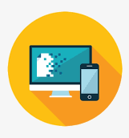
Use Case
Sync Service
Auth Service
Database
Database

Slide 7
Why Monitoring
Better Visibility and Transparency
Facilitates Rapid Responses
Minimizes System Downtime
Assists with Healthy Business Performance
Cost Effective
Better Serve the Business

Slide 8
What can we Monitor
Infrastructure
Applications
CI Pipeline
Certificates

Slide 9

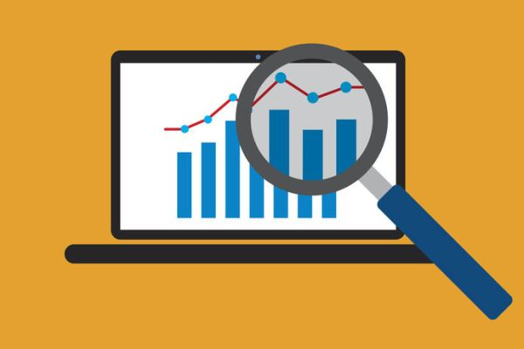
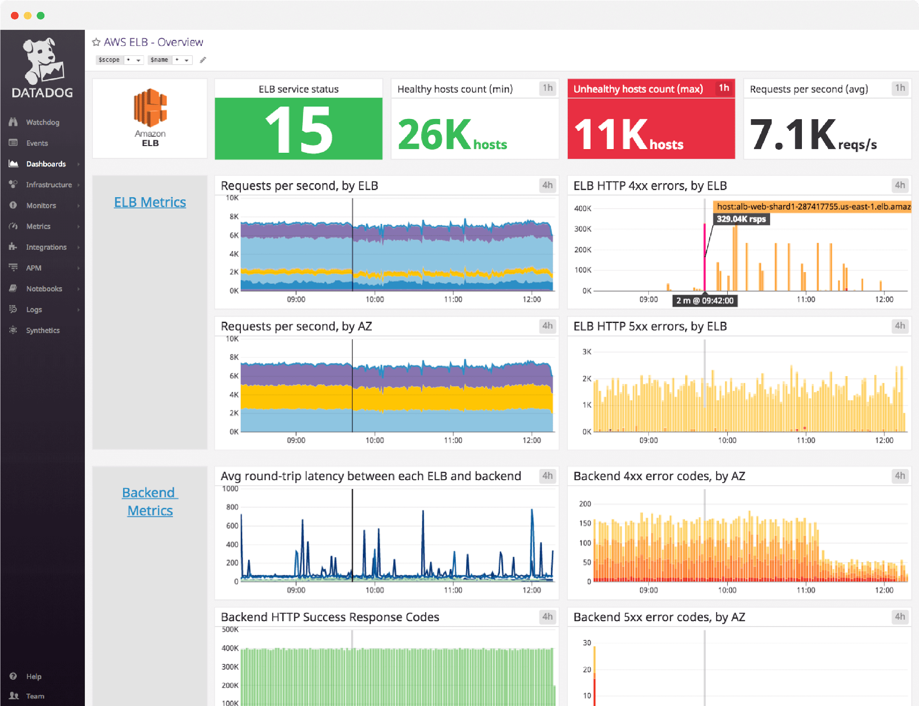
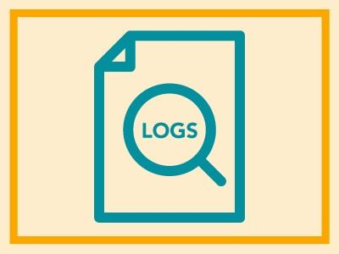
How to monitor
Trigger alerts when metrics exceed certain thresholds
Collect metrics over time
Provide a dashboard of key service health components in a glance
Create databases of logs that can be queried

Slide 10
Observability and Monitoring
Monitoring is capturing and displaying data
A system is observable if it emits useful data about its internal state, which is crucial for determining root cause.

Slide 11
Monitoring Tools
Datadog
Prometheus
Nagios
AppDynamics

Slide 12
Datadog
Datadog is an observability service for cloud-scale applications, providing monitoring of servers, databases, tools, and services, through a SaaS-based data analytics platform
Types of monitoring:
Host
Event
Security – TLS
UX-Monitoring

Slide 13
Monitor Downtimes
Known maintenance
Schedule downtime
Adhoc maintenance
Mute monitors

Slide 14
Alerting
Emails
Slack Channels
PagerDuty

Slide 15
References
https://www.datadoghq.com/

Slide 16
THANKS!
Any questions?
You can find me @noothanshah

